Slide 1
Challenges of High Volume, High Stress Tests in India
Professor Sanjay G. Dhande
Former Director
IIT Kanpur
November 20, 2015

Slide 2
Size is a challenge, Quality is a challenge
Approximately 100 million tests per year are conducted by the university system in India
Approximately 10 million entrance tests per year are conducted in India
The quality of academic as well as the operation are an issue
The stress induced in the society is coming to a breaking point
The society has to address this situation – the way ahead

Slide 3
Examples of High Volume High Stress Tests in India
School Board Examination at Grade X
School Board Examination at Grade XII
Entrance Examinations for Professional Courses – Indian
Entrance Examinations – International
Post-graduate level examinations
Examinations for interview selection
Certification examination for skills
University examinations

Slide 4
Different Dimensions of a Test
Academic Dimension of a Test
Operational Dimension of a Test
Administrative Dimension of a Test
Stress Dimension of a Test
Feedback Dimension of a Test
Technology Dimension of a Test
Economic Dimension of a Test
Coaching Dimension of a Test

Slide 5
The studies, the studies, the studies…

Slide 6
The beginning of the examination….

Slide 7
But for some, it is a surprise!

Slide 8
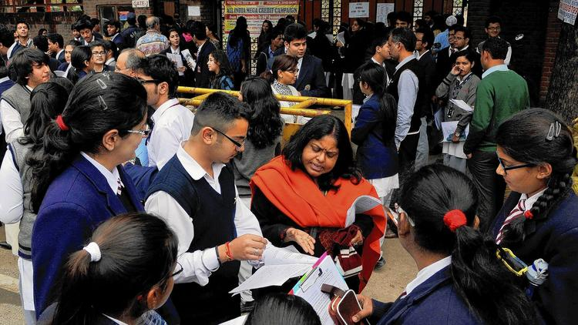
The intensive analysis after the exam…

Slide 9
And the joy of graduation!!!!

Slide 10
The things boys and girls do in an examination…

Slide 11
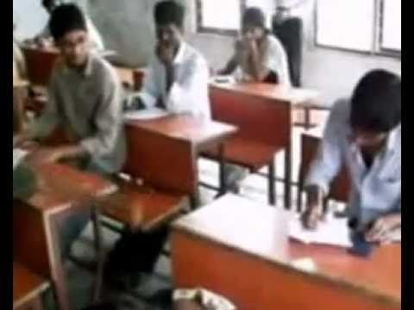
The eye sight wanders for answers…

Slide 12
And the answer is…..

Slide 13
May be the correct answer is in the chits and support pages….

Slide 14
The legs are indeed the arch pillars of….
Cheating requires the body language as well…

Slide 15
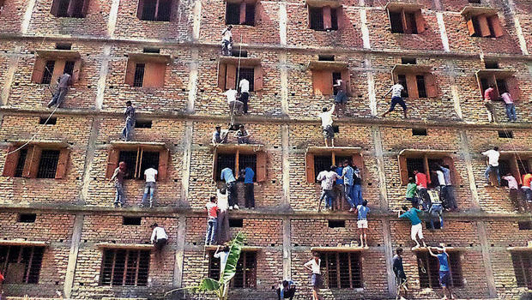
This is the picture that tells you all….

Slide 16
And this one as well…
A friend in need is a friend indeed

Slide 17
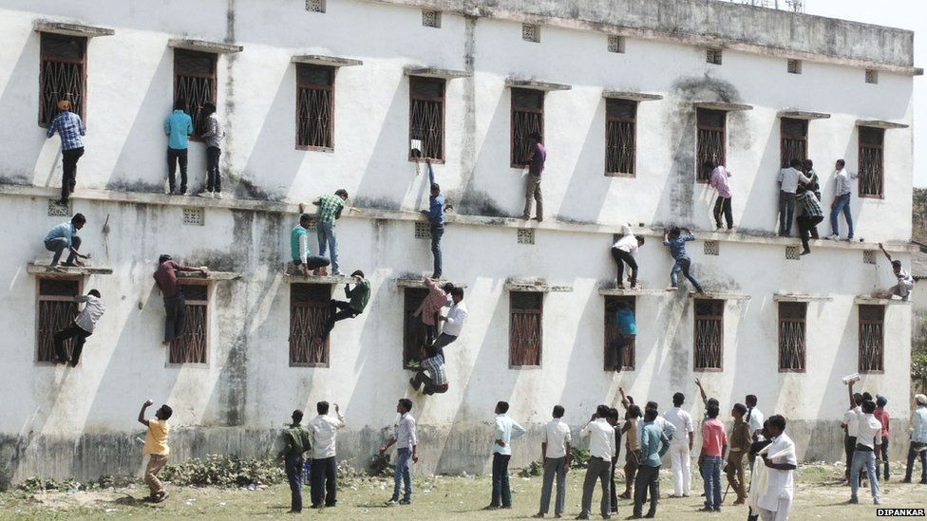
The valuable ground support for the operation…

Slide 18
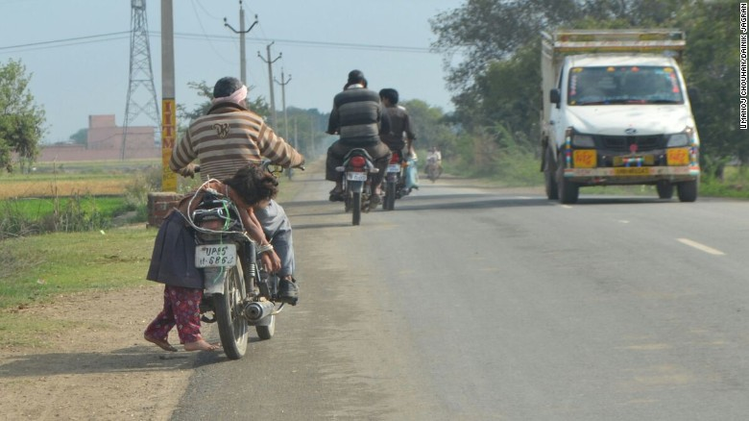
This is what parents do …

Slide 19
This is how one ends up after…
What happens when…

Slide 20
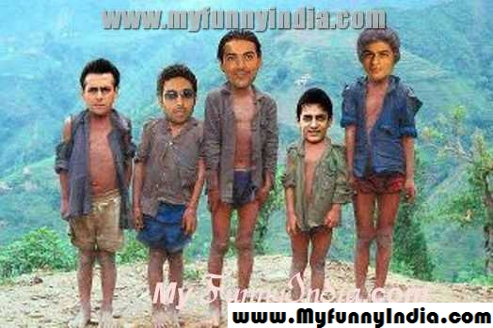
Future when you do not pass an exam..

Slide 21
The true grit spirit of exam….

Slide 22
The writing brigade marches on…

Slide 23
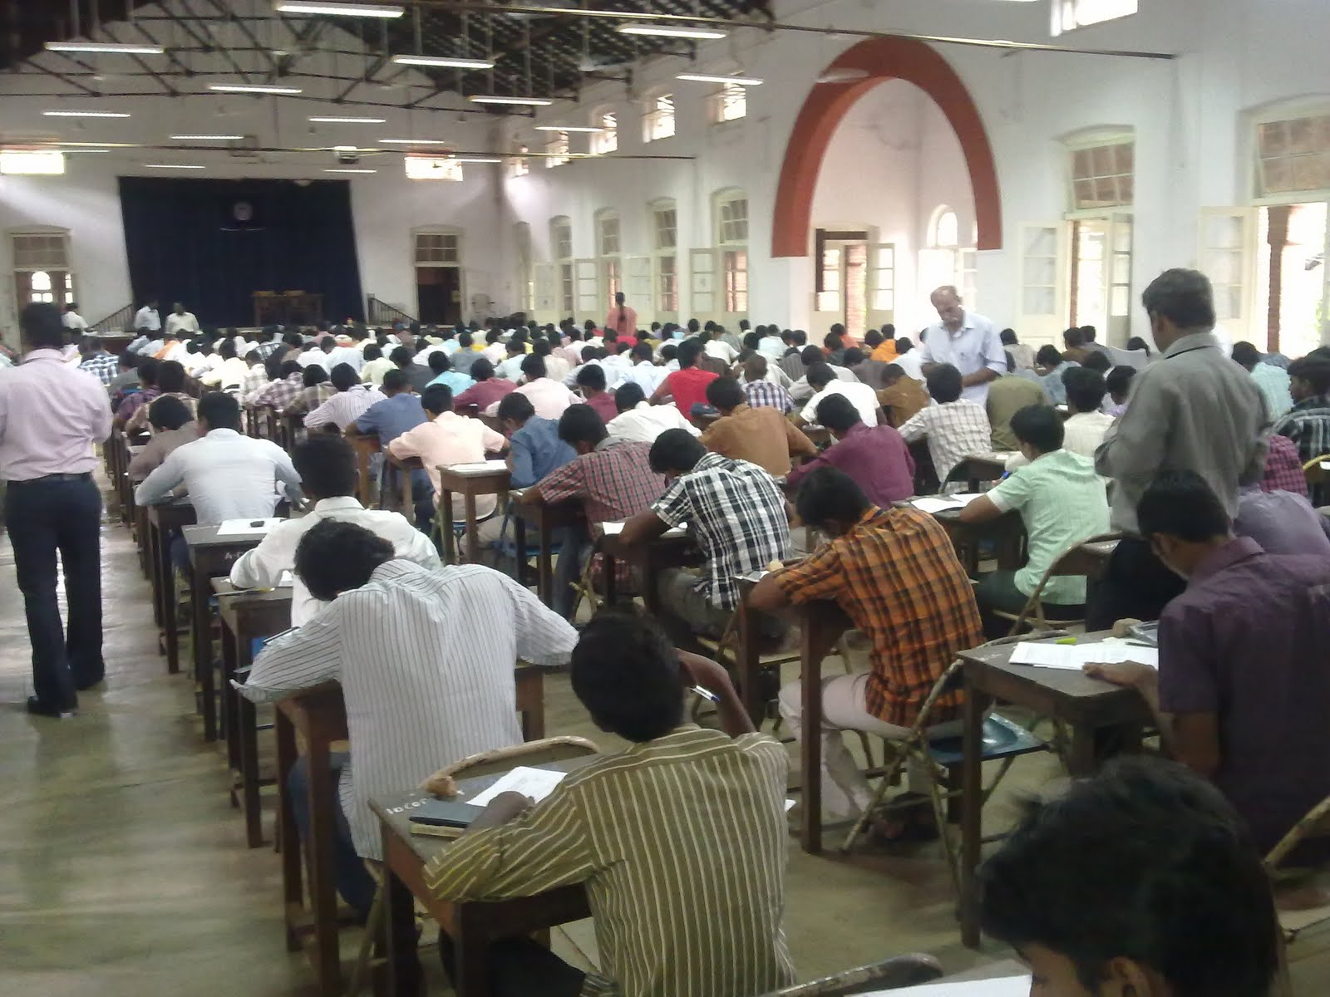
All under control, so it seems…

Slide 24
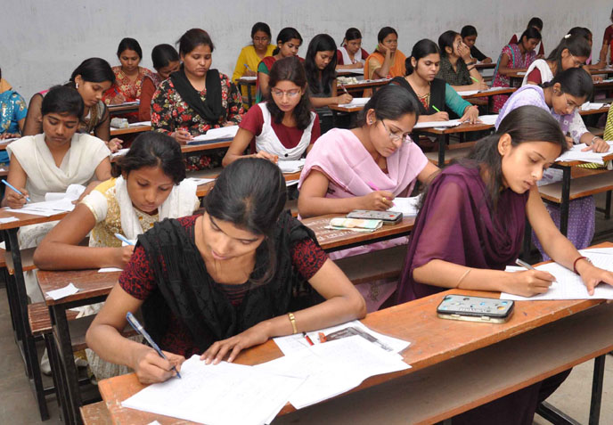
Who says there is gender inequality?...

Slide 25
While the exam is in progress…

Slide 26
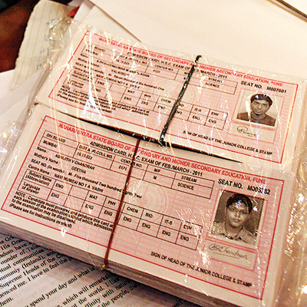
The Great Cards…

Slide 27
Three Elements of Education
Teaching
Learning
Testing
Teaching – MOOCs, LMSs,
Learning – Open Courseware
Testing - ?
Design, conduct and grade successfully.

Slide 28
Examples of Poor Show
AIPMT judgment of Honorable Supreme Court
Vyapam scandal – high premium on admissions
Leakage of question paper
Mistakes in questions – academic
Mistakes in questions – typographical
Mistakes in questions – translational
Court cases challenging grading
Re-evaluation procedure and need
Impersonation and proxy answering

Slide 29
World Scenario of Testing
Asian countries suffer from high stress tests
Volumes are high particularly in China and India
Educational Testing Services – ETS is the grand old lady of testing world
About 200 top companies around the world
About top 10 educational institutions in testing
Science, art and technology of testing needs to evolve in India
About 10 companies in India serving the world of testing

Slide 30
Academic Dimensions
Role of subject matter experts
Role of test designers
Evaluation of a test item before the test
Evaluation of a test item after the test
Multiple choice test
Descriptive test
Other methods of testing – KBC
Tough questions
Trick questions

Slide 31
Operational Dimensions
Quality of examination hall / test centers
Electric supply, Security, Medical facilities, Disturbances
Printing of test papers, answer sheets (blanks)
Printing of support documents – admit cards, lists
Appointment of invigilators, supervisors, center chiefs
Distribution of material at test centers
Transportation and scanning of answer scripts
Coding, grading and processing of results

Slide 32
Administrative Aspects
Management of Subject Matter Experts (SMEs)
Management of Test Design Experts (TDEs)
Management of Registration process
Contractual arrangement of test centers
Media coordination, Web site coordination
Test advisory body, Test management body
Core staff of administration – integrity
Safety audit of the processes
Management of student grievances, court cases

Slide 33
Stress Dimension of a Test
Psychological stress for students
Health / Anxiety related physiological issues
Understanding success / failure at philosophical level
Counseling regarding food diet, exercises, concentration, recreation
Counseling regarding career planning and dynamic model of career path planning
Counseling of parents

Slide 34
Feedback Aspects of a Test
Interactive testing – music, skills like archery, shooting
Examination test – questions (items)
Multiple choice, Descriptive answers
Feedback aspect versus Guillotine
Test analysis should give strengths and weaknesses
Test analysis should give the way forward for students
Mock tests should reduce the fear of tests

Slide 35
Technology Dimensions of a Test
Pre-lecture, In-lecture, Post-lecture engagements
Open Courseware, Coursera, Udacity etc
Learning Management Systems like WebCT, MOODLE
Course App with lectures, tutorials, homeworks, tests and feedbacks
Pareira technology for lectures and questions
Biometric for attendance
Feedback to students, teachers, parents, administrators

Slide 36
Economic Aspects of a Test
University exams provide additional income to faculty members for setting the test and grading the test
Entrance examinations is a revenue earner for some institutions
Examination fees are going up and students have to appear for several tests, cost of tests is a matter of concern
Technology for reducing the cost is not used or used in a very minor way

Slide 37
Coaching Culture in India
Preparations for all high volume, high stress tests require preparations beyond home work and schools / colleges
Gray market of education – coaching – is a reality in India
Kota, Hyderabad and many towns have become coaching hubs
Even for regular courses of a university, the coaching culture flourishes so as to get good grades at the university

Slide 38
Action Plan Suggested
Use the method of equating and hold a test on several days in a year
Use the modern technology of development of a test using SMEs and TDEs
Use the techniques of Psychometry for evaluation of a test / item
Train the faculty members so that the culture of quality testing spreads in Indian academia
Quality testing should use the technology for assessment – any APP?

Slide 39
Long Term Planning
Testing should provide a positive feedback to students
Students should be able to take a test as and when they feel they are ready
Teaching and testing should go hand in hand
Technology based testing is the way forward for a large student population and limited resources
Create a cadre of quality testing professionals
Involve the testing companies

Slide 40
Conclusions
Future of testing is VERY BIG in a country like India
However, this potential can be harnessed only if the transformation of testing from an old system to a modern technology based system is ushered in a quick time
Rather than setting up a central testing agency, it is desirable to create a distributed infrastructure of testing throughout the country
University, School Boards and Testing Companies should create an alliance

